Slide 1






FUNDAMENTALS OF USER EXPERIENCE DESIGN
Lesson 2: The Anatomy of User Experience
Sarah Kahn
UX Engineer, Adzerk.com
@aarahkahak

Slide 2


Information Architecture
Interaction Design
Visual Design
Assignment

Slide 3

Warning- dry content ahead

Slide 4
User Experience is broad

Slide 5
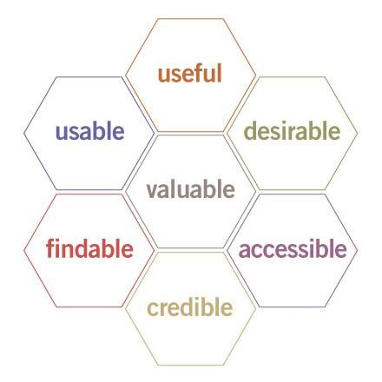
The User Experience Honeycomb, by Peter Morville

Slide 6
What is Information Architecture?

Slide 7
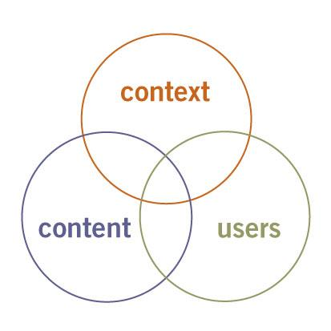
The Three Circles of Information Architecture, by Peter Morville

Slide 8
http://www.yahoo.com/

Slide 9
What is Interaction Design?

Slide 10
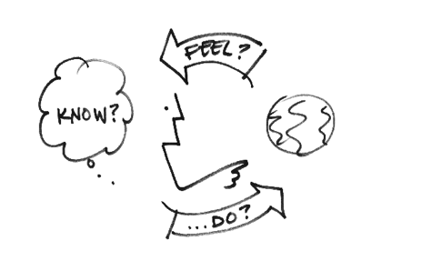
Interaction Design is the process of creating a path that takes the user through a series of tasks

Slide 11
http://groupon.com

Slide 12
Separating Visual Design

Slide 13
http://groupon.com

Slide 14


Your Assignment
Visit http://msnbc.com
Identify an element of information architecture on this site (hint- navigation menus, breadcrumbs, and page headings are all examples).
Identify an element of interaction design (hint- verbs/action words usually indicate an interaction).
Identify an element of visual design.
Pick one thing you'd do differently, and sketch it out- whether it's reorganizing a navigation menu, or reorganizing a sign-in form, etc.

Slide 15

NEXT TIME:
Fundamentals of User Experience Design: Lesson 3: Getting Started

